Slide 1

One Identity
One Identity Manager 8.0

Slide 2
One Identity Manager
Simplifies the process of managing User Identities, Access Permissions and Security Policies.
Way of Request - ITShop, Shopping Cart and Cart Items.
Wide scope for customizations of processes, user interface, or tool itself.

Slide 3
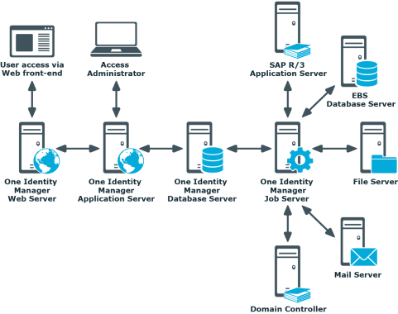
Architecture

Slide 4
1. Database Layer
Consists of two logical parts: Payload, Metadata
Payload data – Information required to maintain data. For example: Employees, User Accounts, Workflows, Attestation, etc;
Metadata – Consists of configuration of entire 1IM system. For example: Scripts, Templates, Configuration params, WebApp config, etc;
Database queue – Tasks queue for processing based on priority.
DBQueueProcessor – DB execution of tasks.

Slide 5
2. Application Layer
App server provides a connection pool for accessing database securely.
Data is sent to database when an object is saved.
3. Web Server
A default browser based web application is hosted.
Users access the web portal for all kinds of activities.

Slide 6
1IM Tools
(Demonstration)

Slide 7
Questions
?
?
?

